Slide 1


Tutorial: Recommender Systems International Joint Conference on Artificial Intelligence Beijing, August 4, 2013
Dietmar Jannach
TU Dortmund
Gerhard Friedrich
Alpen-Adria Universität Klagenfurt

Slide 2


Slide 3

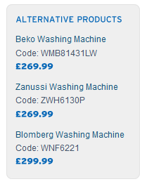
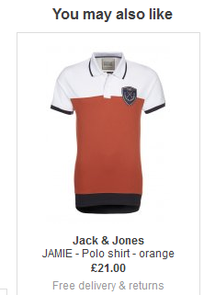

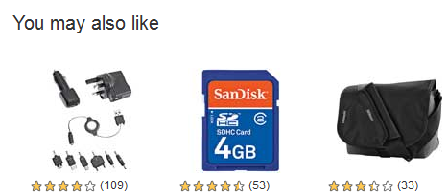
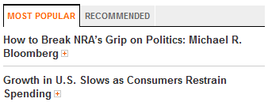
Recommender Systems
Application areas

Slide 4
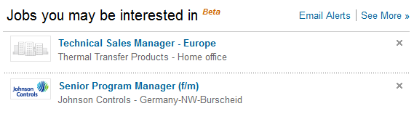
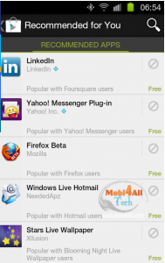
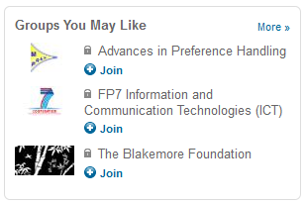
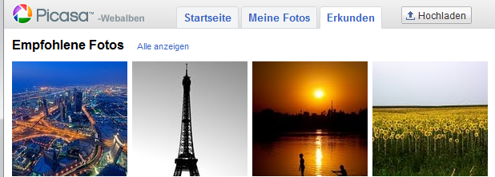
In the Social Web

Slide 5
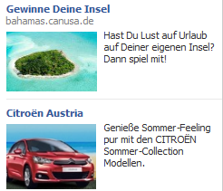
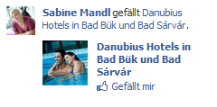
Even more …
Personalized search
"Computational advertising"

Slide 6
About the speakers
Gerhard Friedrich
Professor at University Klagenfurt, Austria
Dietmar Jannach
Professor at TU Dortmund, Germany
Research background and interests
Application of Intelligent Systems technology in business
Recommender systems implementation & evaluation
Product configuration systems
Web mining
Operations research

Slide 7
Agenda
What are recommender systems for?
Introduction
How do they work (Part I) ?
Collaborative Filtering
How to measure their success?
Evaluation techniques
How do they work (Part II) ?
Content-based Filtering
Knowledge-Based Recommendations
Hybridization Strategies
Advanced topics
Explanations
Human decision making

Slide 8

Introduction

Slide 9
Why using Recommender Systems?
Value for the customer
Find things that are interesting
Narrow down the set of choices
Help me explore the space of options
Discover new things
Entertainment
…
Value for the provider
Additional and probably unique personalized service for the customer
Increase trust and customer loyalty
Increase sales, click trough rates, conversion etc.
Opportunities for promotion, persuasion
Obtain more knowledge about customers
…

Slide 10
Real-world check
Myths from industry
Amazon.com generates X percent of their sales through the recommendation lists (30 < X < 70)
Netflix (DVD rental and movie streaming) generates X percent of their sales through the recommendation lists (30 < X < 70)
There must be some value in it
See recommendation of groups, jobs or people on LinkedIn
Friend recommendation and ad personalization on Facebook
Song recommendation at last.fm
News recommendation at Forbes.com (plus 37% CTR)
Academia
A few studies exist that show the effect
increased sales, changes in sales behavior

Slide 11



Problem domain
Recommendation systems (RS) help to match users with items
Ease information overload
Sales assistance (guidance, advisory, persuasion,…)
RS are software agents that elicit the interests and preferences of individual consumers […] and make recommendations accordingly.
They have the potential to support and improve the quality of the decisions consumers make while searching for and selecting products online.
[Xiao & Benbasat, MISQ, 2007]
Different system designs / paradigms
Based on availability of exploitable data
Implicit and explicit user feedback
Domain characteristics

Slide 12
Recommender systems
RS seen as a function [AT05]
Given:
User model (e.g. ratings, preferences, demographics, situational context)
Items (with or without description of item characteristics)
Find:
Relevance score. Used for ranking.
Finally:
Recommend items that are assumed to be relevant
But:
Remember that relevance might be context-dependent
Characteristics of the list itself might be important (diversity)

Slide 13
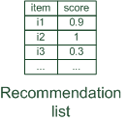

Paradigms of recommender systems
Recommender systems reduce information overload by estimating relevance

Slide 14


Paradigms of recommender systems
Personalized recommendations

Slide 15

Paradigms of recommender systems
Collaborative: "Tell me what's popular among my peers"

Slide 16

Paradigms of recommender systems
Content-based: "Show me more of the same what I've liked"

Slide 17


Paradigms of recommender systems
Knowledge-based: "Tell me what fits based on my needs"

Slide 18
Paradigms of recommender systems
Hybrid: combinations of various inputs and/or composition of different mechanism

Slide 19


Recommender systems: basic techniques
 | Pros | Cons
Collaborative | No knowledge-engineering effort, serendipity of results, learns market segments | Requires some form of rating feedback, cold start for new users and new items
Content-based | No community required, comparison between items possible | Content descriptions necessary, cold start for new users, no surprises
Knowledge-based | Deterministic recommendations, assured quality, no cold-start, can resemble sales dialogue | Knowledge engineering effort to bootstrap, basically static, does not react to short-term trends

Slide 20
Collaborative Filtering

Slide 21
Collaborative Filtering (CF)
The most prominent approach to generate recommendations
used by large, commercial e-commerce sites
well-understood, various algorithms and variations exist
applicable in many domains (book, movies, DVDs, ..)
Approach
use the "wisdom of the crowd" to recommend items
Basic assumption and idea
Users give ratings to catalog items (implicitly or explicitly)
Customers who had similar tastes in the past, will have similar tastes in the future

Slide 22
1992: Using collaborative filtering to weave an information tapestry, D. Goldberg et al., Communications of the ACM
Basic idea: "Eager readers read all docs immediately, casual readers wait for the eager readers to annotate"
Experimental mail system at Xerox Parc that records reactions of users when reading a mail
Users are provided with personalized mailing list filters instead of being forced to subscribe
Content-based filters (topics, from/to/subject…)
Collaborative filters
E.g. Mails to [all] which were replied by [John Doe] and which received positive ratings from [X] and [Y].

Slide 23
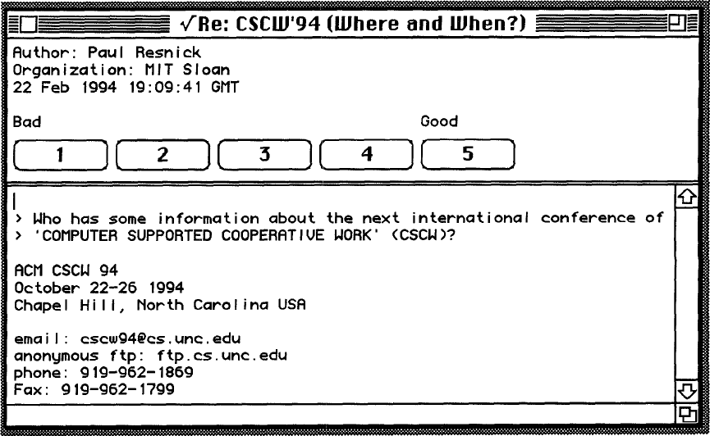
1994: GroupLens: an open architecture for collaborative filtering of netnews, P. Resnick et al., ACM CSCW
Tapestry system does not aggregate ratings and requires knowing each other
Basic idea: "People who agreed in their subjective evaluations in the past are likely to agree again in the future"
Builds on newsgroup browsers with rating functionality

Slide 24
User-based nearest-neighbor collaborative filtering (1)
The basic technique:
Given an "active user" (Alice) and an item I not yet seen by Alice
The goal is to estimate Alice's rating for this item, e.g., by
find a set of users (peers) who liked the same items as Alice in the past and who have rated item I
use, e.g. the average of their ratings to predict, if Alice will like item I
do this for all items Alice has not seen and recommend the best-rated
 | Item1 | Item2 | Item3 | Item4 | Item5
Alice | 5 | 3 | 4 | 4 | ?
User1 | 3 | 1 | 2 | 3 | 3
User2 | 4 | 3 | 4 | 3 | 5
User3 | 3 | 3 | 1 | 5 | 4
User4 | 1 | 5 | 5 | 2 | 1

Slide 25

User-based nearest-neighbor collaborative filtering (2)
Some first questions
How do we measure similarity?
How many neighbors should we consider?
How do we generate a prediction from the neighbors' ratings?
 | Item1 | Item2 | Item3 | Item4 | Item5
Alice | 5 | 3 | 4 | 4 | ?
User1 | 3 | 1 | 2 | 3 | 3
User2 | 4 | 3 | 4 | 3 | 5
User3 | 3 | 3 | 1 | 5 | 4
User4 | 1 | 5 | 5 | 2 | 1

Slide 26
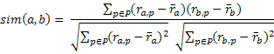
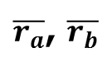
Measuring user similarity
A popular similarity measure in user-based CF: Pearson correlation
a, b : users
r_{a,p} : rating of user a for item p
P : set of items, rated both by a and b
Possible similarity values between -1 and 1; = user's average ratings
$\overline{r_{a}}$, $\overline{r_{b}}$
 | Item1 | Item2 | Item3 | Item4 | Item5
Alice | 5 | 3 | 4 | 4 | ?
User1 | 3 | 1 | 2 | 3 | 3
User2 | 4 | 3 | 4 | 3 | 5
User3 | 3 | 3 | 1 | 5 | 4
User4 | 1 | 5 | 5 | 2 | 1
sim = 0,85
sim = 0,70
sim = -0,79

Slide 27
Pearson correlation
Takes differences in rating behavior into account
Works well in usual domains, compared with alternative measures
such as cosine similarity

Slide 28
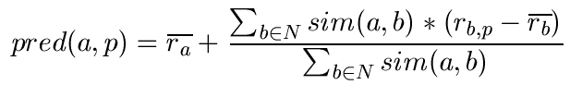

Making predictions
A common prediction function:
Calculate, whether the neighbors' ratings for the unseen item i are higher or lower than their average
Combine the rating differences – use the similarity as a weight
Add/subtract the neighbors' bias from the active user's average and use this as a prediction

Slide 29
Making recommendations
Making predictions is typically not the ultimate goal
Usual approach (in academia)
Rank items based on their predicted ratings
However
This might lead to the inclusion of (only) niche items
In practice also: Take item popularity into account
Approaches
"Learning to rank"
Optimize according to a given rank evaluation metric (see later)

Slide 30
Improving the metrics / prediction function
Not all neighbor ratings might be equally "valuable"
Agreement on commonly liked items is not so informative as agreement on controversial items
Possible solution: Give more weight to items that have a higher variance
Value of number of co-rated items
Use "significance weighting", by e.g., linearly reducing the weight when the number of co-rated items is low
Case amplification
Intuition: Give more weight to "very similar" neighbors, i.e., where the similarity value is close to 1.
Neighborhood selection
Use similarity threshold or fixed number of neighbors

Slide 31
Memory-based and model-based approaches
User-based CF is said to be "memory-based"
the rating matrix is directly used to find neighbors / make predictions
does not scale for most real-world scenarios
large e-commerce sites have tens of millions of customers and millions of items
Model-based approaches
based on an offline pre-processing or "model-learning" phase
at run-time, only the learned model is used to make predictions
models are updated / re-trained periodically
large variety of techniques used
model-building and updating can be computationally expensive

Slide 32
2001: Item-based collaborative filtering recommendation algorithms, B. Sarwar et al., WWW 2001
Scalability issues arise with U2U if many more users than items (m >> n , m = |users|, n = |items|)
e.g. Amazon.com
Space complexity O(m²) when pre-computed
Time complexity for computing Pearson O(m²n)
High sparsity leads to few common ratings between two users
Basic idea: "Item-based CF exploits relationships between items first, instead of relationships between users"

Slide 33
Item-based collaborative filtering
Basic idea:
Use the similarity between items (and not users) to make predictions
Example:
Look for items that are similar to Item5
Take Alice's ratings for these items to predict the rating for Item5
 | Item1 | Item2 | Item3 | Item4 | Item5
Alice | 5 | 3 | 4 | 4 | ?
User1 | 3 | 1 | 2 | 3 | 3
User2 | 4 | 3 | 4 | 3 | 5
User3 | 3 | 3 | 1 | 5 | 4
User4 | 1 | 5 | 5 | 2 | 1

Slide 34
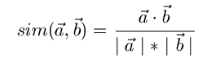
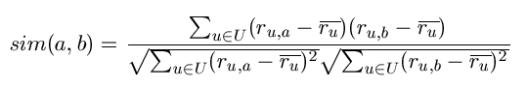
The cosine similarity measure
Produces better results in item-to-item filtering
for some datasets, no consistent picture in literature
Ratings are seen as vector in n-dimensional space
Similarity is calculated based on the angle between the vectors
Adjusted cosine similarity
take average user ratings into account, transform the original ratings
U: set of users who have rated both items a and b

Slide 35
Pre-processing for item-based filtering
Item-based filtering does not solve the scalability problem itself
Pre-processing approach by Amazon.com (in 2003)
Calculate all pair-wise item similarities in advance
The neighborhood to be used at run-time is typically rather small, because only items are taken into account which the user has rated
Item similarities are supposed to be more stable than user similarities
Memory requirements
Up to N² pair-wise similarities to be memorized (N = number of items) in theory
In practice, this is significantly lower (items with no co-ratings)
Further reductions possible
Minimum threshold for co-ratings (items, which are rated at least by n users)
Limit the size of the neighborhood (might affect recommendation accuracy)

Slide 36
More on ratings
Pure CF-based systems only rely on the rating matrix
Explicit ratings
Most commonly used (1 to 5, 1 to 7 Likert response scales)
Research topics
"Optimal" granularity of scale; indication that 10-point scale is better accepted in movie domain
Multidimensional ratings (multiple ratings per movie)
Challenge
Users not always willing to rate many items; sparse rating matrices
How to stimulate users to rate more items?
Implicit ratings
clicks, page views, time spent on some page, demo downloads …
Can be used in addition to explicit ones; question of correctness of interpretation

Slide 37
Data sparsity problems
Cold start problem
How to recommend new items? What to recommend to new users?
Straightforward approaches
Ask/force users to rate a set of items
Use another method (e.g., content-based, demographic or simply non-personalized) in the initial phase
Alternatives
Use better algorithms (beyond nearest-neighbor approaches)
Example:
In nearest-neighbor approaches, the set of sufficiently similar neighbors might be to small to make good predictions
Assume "transitivity" of neighborhoods

Slide 38
Example algorithms for sparse datasets
Recursive CF
Assume there is a very close neighbor n of u who however has not rated the target item i yet.
Idea:
Apply CF-method recursively and predict a rating for item i for the neighbor
Use this predicted rating instead of the rating of a more distant direct neighbor
 | Item1 | Item2 | Item3 | Item4 | Item5
Alice | 5 | 3 | 4 | 4 | ?
User1 | 3 | 1 | 2 | 3 | ?
User2 | 4 | 3 | 4 | 3 | 5
User3 | 3 | 3 | 1 | 5 | 4
User4 | 1 | 5 | 5 | 2 | 1
sim = 0,85
Predict rating for
User1

Slide 39
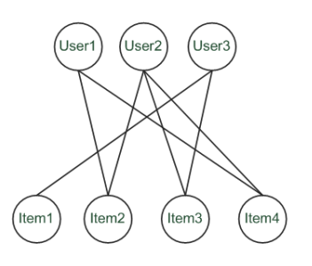
Graph-based methods
"Spreading activation" (sketch)
Idea: Use paths of lengths > 3 to recommend items
Length 3: Recommend Item3 to User1
Length 5: Item1 also recommendable

Slide 40
More model-based approaches
Plethora of different techniques proposed in the last years, e.g.,
Matrix factorization techniques, statistics
singular value decomposition, principal component analysis
Association rule mining
compare: shopping basket analysis
Probabilistic models
clustering models, Bayesian networks, probabilistic Latent Semantic Analysis
Various other machine learning approaches
Costs of pre-processing
Usually not discussed
Incremental updates possible?

Slide 41
2000: Application of Dimensionality Reduction in Recommender System, B. Sarwar et al., WebKDD Workshop
Basic idea: Trade more complex offline model building for faster online prediction generation
Singular Value Decomposition for dimensionality reduction of rating matrices
Captures important factors/aspects and their weights in the data
factors can be genre, actors but also non-understandable ones
Assumption that k dimensions capture the signals and filter out noise (K = 20 to 100)
Constant time to make recommendations
Approach also popular in IR (Latent Semantic Indexing), data compression, …

Slide 42

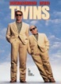



A picture says …
Sue
Bob
Mary
Alice

Slide 43





Matrix factorization
SVD:
U_{k} | Dim1 | Dim2
Alice | 0.47 | -0.30
Bob | -0.44 | 0.23
Mary | 0.70 | -0.06
Sue | 0.31 | 0.93
V_{k}^{T}
Dim1 | -0.44 | -0.57 | 0.06 | 0.38 | 0.57
Dim2 | 0.58 | -0.66 | 0.26 | 0.18 | -0.36
 | Dim1 | Dim2
Dim1 | 5.63 | 0
Dim2 | 0 | 3.23
Prediction:
= 3 + 0.84 = 3.84

Slide 44
Association rule mining
Commonly used for shopping behavior analysis
aims at detection of rules such as
"If a customer purchases baby-food then he also buys diapers in 70% of the cases"
Association rule mining algorithms
can detect rules of the form X => Y (e.g., baby-food => diapers) from a set of sales transactions D = {t₁, t₂, … t_{n}}
measure of quality: support, confidence

Slide 45
Probabilistic methods
Basic idea (simplistic version for illustration):
given the user/item rating matrix
determine the probability that user Alice will like an item i
base the recommendation on such these probabilities
Calculation of rating probabilities based on Bayes Theorem
How probable is rating value "1" for Item5 given Alice's previous ratings?
Corresponds to conditional probability P(Item5=1 | X), where
X = Alice's previous ratings = (Item1 =1, Item2=3, Item3= … )
Can be estimated based on Bayes' Theorem
Usually more sophisticated methods used
Clustering
pLSA …

Slide 46
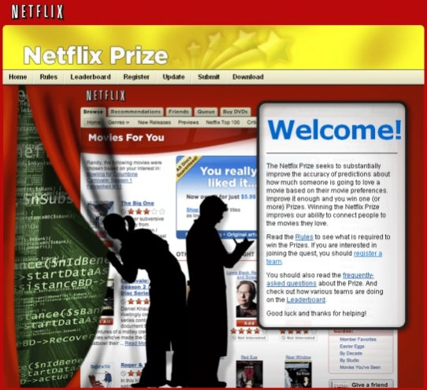
2008: Factorization meets the neighborhood: a multifaceted collaborative filtering model, Y. Koren, ACM SIGKDD
Stimulated by work on Netflix competition
Prize of $1,000,000 for accuracy improvement of 10% RMSE compared to own Cinematch system
Very large dataset (~100M ratings, ~480K users , ~18K movies)
Last ratings/user withheld (set K)
Root mean squared error metric optimized to 0.8567

Slide 47
2008: Factorization meets the neighborhood: a multifaceted collaborative filtering model, Y. Koren, ACM SIGKDD
Merges neighborhood models with latent factor models
Latent factor models
good to capture weak signals in the overall data
Neighborhood models
good at detecting strong relationships between close items
Combination in one prediction single function
Local search method such as stochastic gradient descent to determine parameters
Add penalty for high values to avoid over-fitting

Slide 48
Summarizing recent methods
Recommendation is concerned with learning from noisy observations (x, y), where
has to be determined such that is minimal.
A variety of different learning strategies have been applied trying to estimate f(x)
Non parametric neighborhood models
MF models, SVMs, Neural Networks, Bayesian Networks,…

Slide 49
Collaborative Filtering Issues
Pros:
well-understood, works well in some domains, no knowledge engineering required
Cons:
requires user community, sparsity problems, no integration of other knowledge sources, no explanation of results
What is the best CF method?
In which situation and which domain? Inconsistent findings; always the same domains and data sets; differences between methods are often very small (1/100)
How to evaluate the prediction quality?
MAE / RMSE: What does an MAE of 0.7 actually mean?
Serendipity: Not yet fully understood
What about multi-dimensional ratings?

Slide 50
Evaluation of Recommender Systems

Slide 51


Recommender Systems in e-Commerce
One Recommender Systems research question
What should be in that list?

Slide 52
Recommender Systems in e-Commerce
Another question both in research and practice
How do we know that these are good recommendations?

Slide 53

Recommender Systems in e-Commerce
This might lead to …
What is a good recommendation?
What is a good recommendation strategy?
What is a good recommendation strategy for my business?
We hope you will buy also …
These have been in stock for quite a while now …

Slide 54



What is a good recommendation?
What are the measures in practice?
Total sales numbers
Promotion of certain items
…
Click-through-rates
Interactivity on platform
…
Customer return rates
Customer satisfaction and loyalty

Slide 55
Purpose and success criteria (1)
Different perspectives/aspects
Depends on domain and purpose
No holistic evaluation scenario exists
Retrieval perspective
Reduce search costs
Provide "correct" proposals
Assumption: Users know in advance what they want
Recommendation perspective
Serendipity – identify items from the Long Tail
Users did not know about existence
Notes:
Could a RS be a persuasive technology? In fact depending on the application area RS are deployed to:

Slide 56
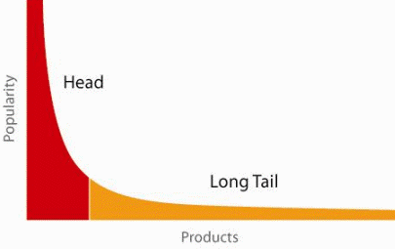
When does a RS do its job well?
"Recommend widely unknown items that users might actually like!"
20% of items accumulate 74% of all positive ratings
Recommend items from the long tail

Slide 57
Purpose and success criteria (2)
Prediction perspective
Predict to what degree users like an item
Most popular evaluation scenario in research
Interaction perspective
Give users a "good feeling"
Educate users about the product domain
Convince/persuade users - explain
Finally, conversion perspective
Commercial situations
Increase "hit", "clickthrough", "lookers to bookers" rates
Optimize sales margins and profit

Slide 58





How do we as researchers know?
Test with real users
A/B tests
Example measures: sales increase, click through rates
Laboratory studies
Controlled experiments
Example measures: satisfaction with the system (questionnaires)
Offline experiments
Based on historical data
Example measures: prediction accuracy, coverage

Slide 59
Empirical research
Characterizing dimensions:
Who is the subject that is in the focus of research?
What research methods are applied?
In which setting does the research take place?
Subject | Online customers, students, historical online sessions, computers, …
Research method | Experiments, quasi-experiments, non-experimental research
Setting | Lab, real-world scenarios

Slide 60
Research methods
Experimental vs. non-experimental (observational) research methods
Experiment (test, trial):
"An experiment is a study in which at least one variable is manipulated and units are randomly assigned to different levels or categories of manipulated variable(s)."
Units: users, historic sessions, …
Manipulated variable: type of RS, groups of recommended items, explanation strategies …
Categories of manipulated variable(s): content-based RS, collaborative RS

Slide 61
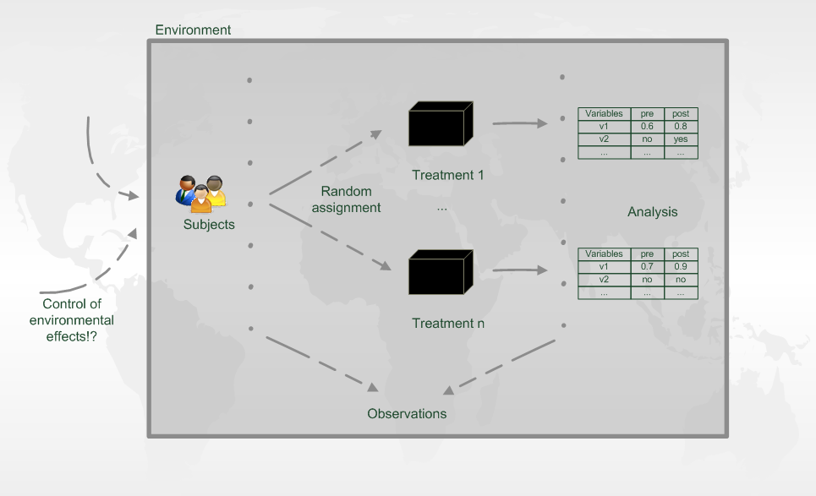
Experiment designs

Slide 62
Evaluation in information retrieval (IR)
Recommendation is viewed as information retrieval task:
Retrieve (recommend) all items which are predicted to be "good" or "relevant".
Common protocol :
Hide some items with known ground truth
Rank items or predict ratings -> Count -> Cross-validate
Ground truth established by human domain experts
 |  | Reality
 |  | Actually Good | Actually Bad
Prediction | Rated Good | True Positive (tp) | False Positive (fp)
 | Rated Bad | False Negative (fn) | True Negative (tn)

Slide 63
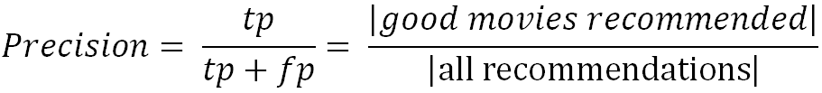
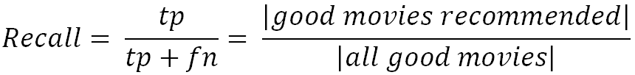
Metrics: Precision and Recall
Precision: a measure of exactness, determines the fraction of relevant items retrieved out of all items retrieved
E.g. the proportion of recommended movies that are actually good
Recall: a measure of completeness, determines the fraction of relevant items retrieved out of all relevant items
E.g. the proportion of all good movies recommended

Slide 64
Dilemma of IR measures in RS
IR measures are frequently applied, however:
Ground truth for most items actually unknown
What is a relevant item?
Different ways of measuring precision possible
Results from offline experimentation may have limited predictive power for online user behavior.

Slide 65
Metrics: Rank Score – position matters
For a user:
Actually good
Item 237
Item 899
Recommended (predicted as good)
Item 345
Item 237
Item 187
hit
Rank Score extends recall and precision to take the positions of correct items in a ranked list into account
Particularly important in recommender systems as lower ranked items may be overlooked by users
Learning-to-rank: Optimize models for such measures (e.g., AUC)

Slide 66
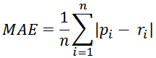
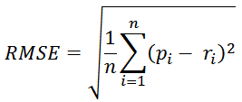
Accuracy measures
Datasets with items rated by users
MovieLens datasets 100K-10M ratings
Netflix 100M ratings
Historic user ratings constitute ground truth
Metrics measure error rate
Mean Absolute Error (MAE) computes the deviation between predicted ratings and actual ratings
Root Mean Square Error (RMSE) is similar to MAE, but places more emphasis on larger deviation

Slide 67
Offline experimentation example
Netflix competition
Web-based movie rental
Prize of $1,000,000 for accuracy improvement (RMSE) of 10% compared to own Cinematch system.
Historical dataset
~480K users rated ~18K movies on a scale of 1 to 5 (~100M ratings)
Last 9 ratings/user withheld
Probe set – for teams for evaluation
Quiz set – evaluates teams’ submissions for leaderboard
Test set – used by Netflix to determine winner
Today
Rating prediction only seen as an additional input into the recommendation process

Slide 68
An imperfect world
Offline evaluation is the cheapest variant
Still, gives us valuable insights
and lets us compare our results (in theory)
Dangers and trends:
Domination of accuracy measures
Focus on small set of domains (40% on movies in CS)
Alternative and complementary measures:
Diversity, Coverage, Novelty, Familiarity, Serendipity, Popularity, Concentration effects (Long tail)

Slide 69
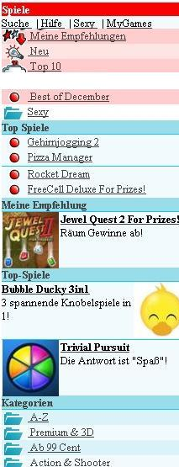
Online experimentation example
Effectiveness of different algorithms for recommending cell phone games [Jannach, Hegelich 09]
Involved 150,000 users on a commercial mobile internet portal
Comparison of recommender methods

Slide 70
Details and results
Recommender variants included:
Item-based collaborative filtering
SlopeOne (also collaborative filtering)
Content-based recommendation
Hybrid recommendation
Top-rated items
Top-sellers
Findings:
Personalized methods increased sales up to 3.6% compared to non-personalized
Choice of recommendation algorithm depends on user situation (e.g. avoid content-based RS in post-sales situation)
} non-personalized

Slide 71
Non-experimental research
Quasi-experiments
Lack random assignments of units to different treatments
Non-experimental / observational research
Surveys / Questionnaires
Longitudinal research
Observations over long period of time
E.g. customer life-time value, returning customers
Case studies
Focus group
Interviews
Think-aloud protocols

Slide 72
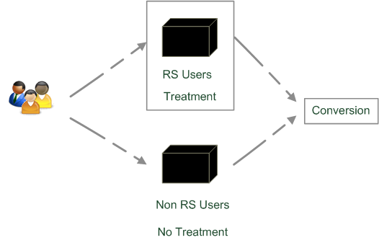
Quasi-experimental
SkiMatcher Resort Finder introduced by Ski-Europe.com to provide users with recommendations based on their preferences
Conversational RS
question and answer dialog
matching of user preferences with knowledge base
Delgado and Davidson evaluated the effectiveness of the recommender over a 4 month period in 2001
Classified as a quasi-experiment as users decide for themselves if they want to use the recommender or not

Slide 73
SkiMatcher Results
 | July | August | September | October
Unique Visitors | 10,714 | 15,560 | 18,317 | 24,416
SkiMatcher Users | 1,027 | 1,673 | 1,878 | 2,558
Non-SkiMatcher Users | 9,687 | 13,887 | 16,439 | 21,858
Requests for Proposals | 272 | 506 | 445 | 641
SkiMatcher Users | 75 | 143 | 161 | 229
Non-SkiMatcher Users | 197 | 363 | 284 | 412
Conversion | 2.54% | 3.25% | 2.43% | 2.63%
SkiMatcher Users | 7.30% | 8.55% | 8.57% | 8.95%
Non-SkiMatcher Users | 2.03% | 2.61% | 1.73% | 1.88%
Increase in Conversion | 359% | 327% | 496% | 475%
[Delgado and Davidson, ENTER 2002]

Slide 74
Interpreting the Results
The nature of this research design means that questions of causality cannot be answered (lack of random assignments), such as
Are users of the recommender systems more likely convert?
Does the recommender system itself cause users to convert?
Some hidden exogenous variable might influence the choice of using RS as well as conversion.
However, significant correlation between using the recommender system and making a request for a proposal
Size of effect has been replicated in other domains
Tourism [Jannach et al., JITT 2009]
Electronic consumer products

Slide 75
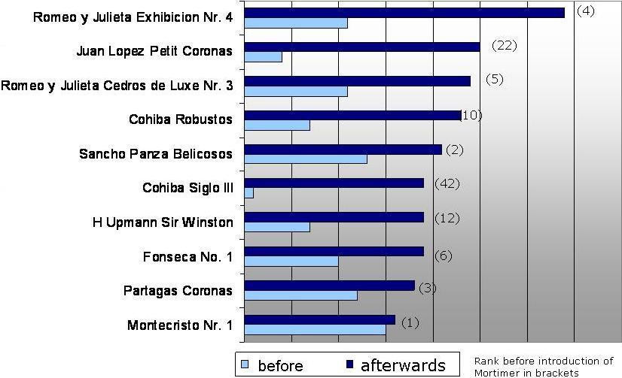
Observational research
Increased demand in niches/long tail products
Ex-post from web shop data [Zanker et al., EC-Web, 2006]

Slide 76
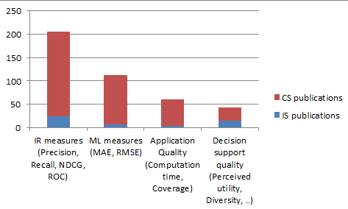
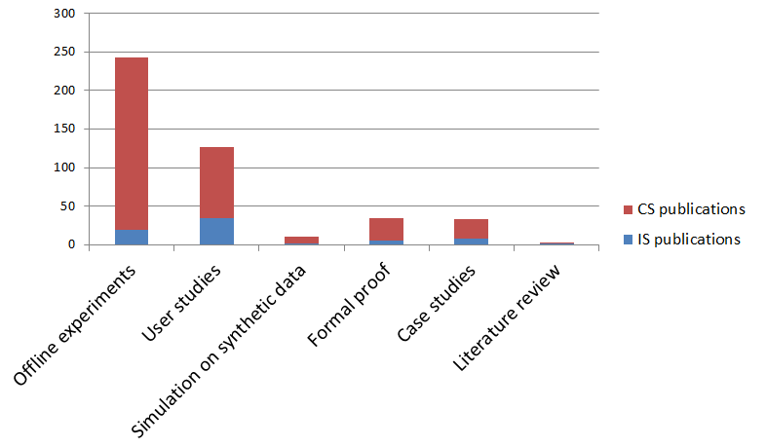
What is popular?
From: Jannach et al., Proceedings EC-Web 2012
User-centric evaluation / User studies
Increased interest in recent years
Various numbers of workshops

Slide 77
What are the next topics?
Two additional major paradigms of recommender systems
Content-based
Knowledge-based
Hybridization: take the best of different paradigms
Advanced topics: recommender systems are about human decision making

Slide 78
Content-based recommendation

Slide 79
Content-based recommendation
Collaborative filtering does NOT require any information about the items,
However, it might be reasonable to exploit such information
E.g. recommend fantasy novels to people who liked fantasy novels in the past
What do we need:
Some information about the available items such as the genre ("content")
Some sort of user profile describing what the user likes (the preferences)
The task:
Learn user preferences
Locate/recommend items that are "similar" to the user preferences

Slide 80
Paradigms of recommender systems
Content-based: "Show me more of the same what I've liked"

Slide 81
What is the "content"?
The genre is actually not part of the content of a book
Most CB-recommendation methods originate from Information Retrieval (IR) field:
The item descriptions are usually automatically extracted (important words)
Goal is to find and rank interesting text documents (news articles, web pages)
Here:
Classical IR-based methods based on keywords
No expert recommendation knowledge involved
User profile (preferences) are rather learned than explicitly elicited

Slide 82
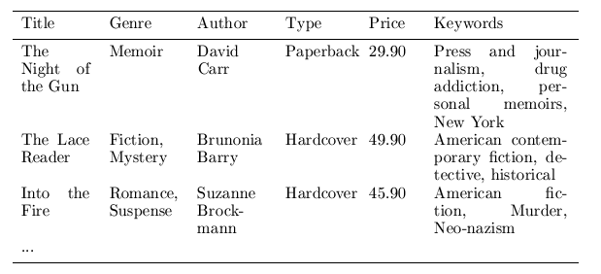
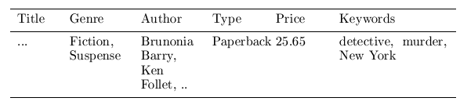
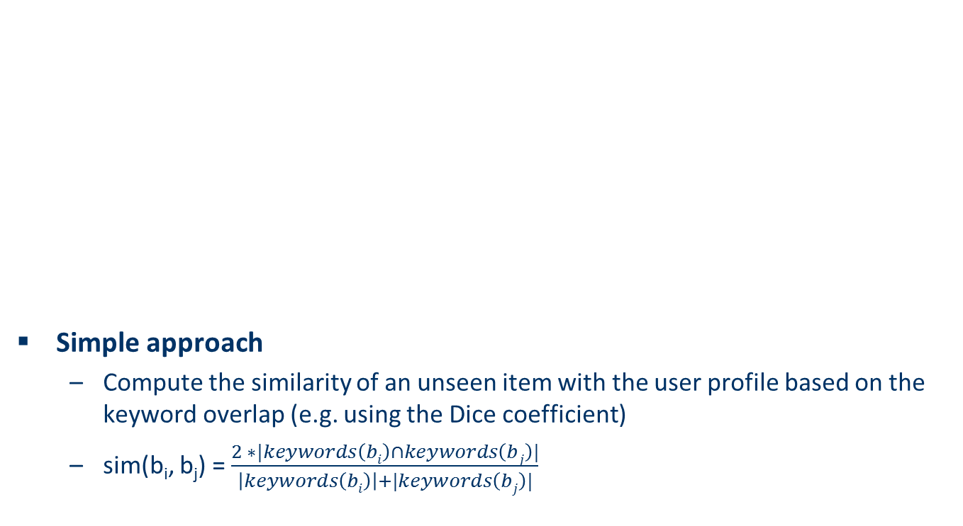
Content representation and item similarities
Simple approach
Compute the similarity of an unseen item with the user profile based on the keyword overlap (e.g. using the Dice coefficient)
sim(b_{i}, b_{j}) = $\frac{2 ∗|keywords\left(bi\right)∩keywords\left(bj\right)|}{\left|keywords\left(bi\right)\right|+|keywords\left(bj\right)|}$
Notes:
Intersection

Slide 83
Term-Frequency - Inverse Document Frequency (TF-IDF)
Simple keyword representation has its problems
In particular when automatically extracted because
Not every word has similar importance
Longer documents have a higher chance to have an overlap with the user profile
Standard measure: TF-IDF
Encodes text documents as weighted term vector
TF: Measures, how often a term appears (density in a document)
Assuming that important terms appear more often
Normalization has to be done in order to take document length into account
IDF: Aims to reduce the weight of terms that appear in all documents

Slide 84
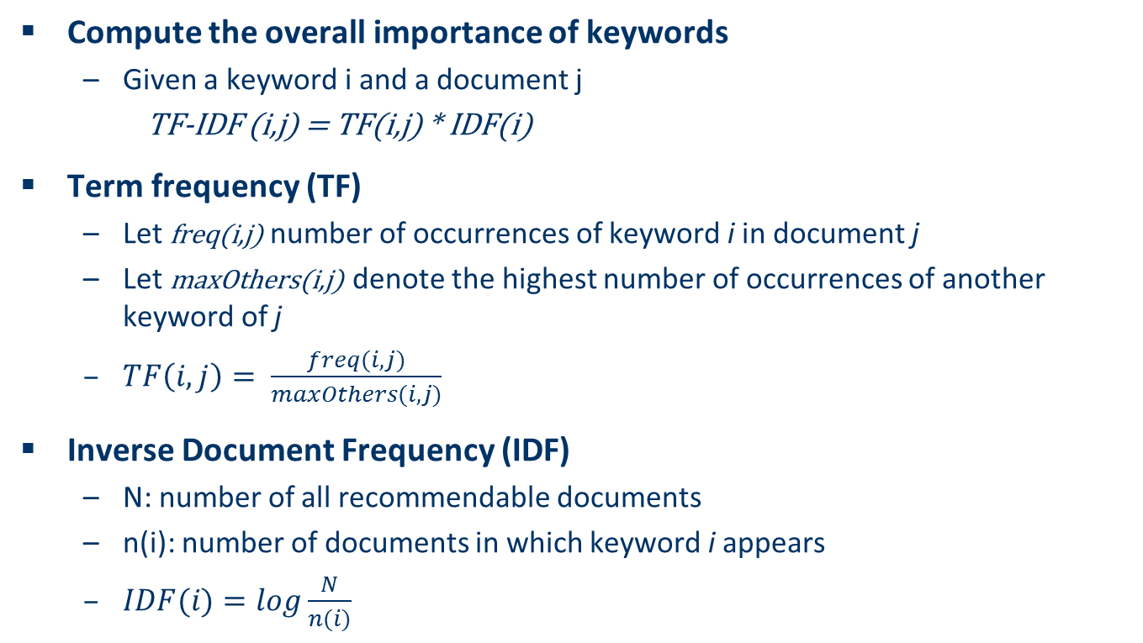
TF-IDF
Compute the overall importance of keywords
Given a keyword i and a document j
TF-IDF (i,j) = TF(i,j) * IDF(i)
Term frequency (TF)
Let freq(i,j) number of occurrences of keyword i in document j
Let maxOthers(i,j) denote the highest number of occurrences of another keyword of j
$TF\left(i,j\right)= \frac{freq(i,j)}{maxOthers(i,j)}$
Inverse Document Frequency (IDF)
N: number of all recommendable documents
n(i): number of documents in which keyword i appears
$IDF(i)=log\frac{N}{n(i)}$

Slide 85
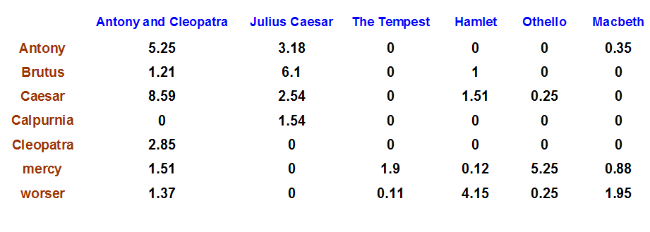
Example TF-IDF representation
Figure taken from http://informationretrieval.org

Slide 86
More on the vector space model
Vectors are usually long and sparse
Improvements
Remove stop words ("a", "the", ..)
Use stemming
Size cut-offs (only use top n most representative words, e.g. around 100)
Use additional knowledge, use more elaborate methods for feature selection
Detection of phrases as terms (such as United Nations)
Limitations
Semantic meaning remains unknown
Example: usage of a word in a negative context
"there is nothing on the menu that a vegetarian would like.."
Usual similarity metric to compare vectors: Cosine similarity (angle)

Slide 87
Recommending items
Simple method: nearest neighbors
Given a set of documents D already rated by the user (like/dislike)
Find the n nearest neighbors of a not-yet-seen item i in D
Take these ratings to predict a rating/vote for i
(Variations: neighborhood size, lower/upper similarity thresholds)
Query-based retrieval: Rocchio's method
The SMART System: Users are allowed to rate (relevant/irrelevant) retrieved documents (feedback)
The system then learns a prototype of relevant/irrelevant documents
Queries are then automatically extended with additional terms/weight of relevant documents

Slide 88
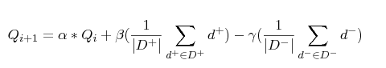
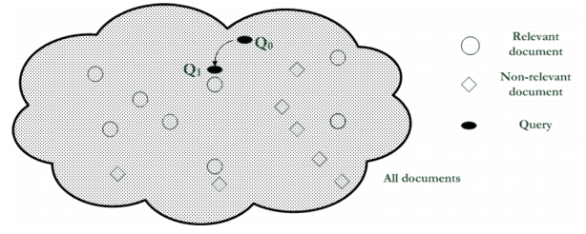
Rocchio details
Document collections D⁺ and D⁻
α, β, γ used to fine-tune the feedback
often only positive feedback is used

Slide 89
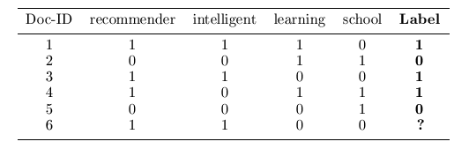
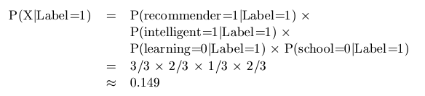
Probabilistic methods
Recommendation as classical text classification problem
Long history of using probabilistic methods
Simple approach:
2 classes: like/dislike
Simple Boolean document representation
Calculate probability that document is liked/disliked based on Bayes theorem
Remember:
P(Label=1|X)= k*P(X|Label=1) * P(Label=1)

Slide 90
Improvements
Side note: Conditional independence of events does in fact not hold
“New”/ “York“ and “Hong” / “Kong"
Still, good accuracy can be achieved
Boolean representation simplistic
Keyword counts lost
More elaborate probabilistic methods
E.g. estimate probability of term v occurring in a document of class C by relative frequency of v in all documents of the class
Other linear classification algorithms (machine learning) can be used
Support Vector Machines, ..

Slide 91
Limitations of content-based recommendation methods
Keywords alone may not be sufficient to judge quality/relevance of a document or web page
Up-to-dateness, usability, aesthetics, writing style
Content may also be limited / too short
Content may not be automatically extractable (multimedia)
Ramp-up phase required
Some training data is still required
Web 2.0: Use other sources to learn the user preferences
Overspecialization
Algorithms tend to propose "more of the same"
E.g. too similar news items

Slide 92

Knowledge-Based Recommender Systems

Slide 93


Why do we need knowledge-based recommendation?
Products with low number of available ratings
Time span plays an important role
Five-year-old ratings for computers
User lifestyle or family situation changes
Customers want to define their requirements explicitly
“The color of the car should be black"

Slide 94
Knowledge-based recommendation
Knowledge-based: "Tell me what fits based on my needs"

Slide 95
Knowledge-based recommendation I
Explicit domain knowledge
Sales knowledge elicitation from domain experts
System mimics the behavior of experienced sales assistant
Best-practice sales interactions
Can guarantee “correct” recommendations (determinism) with respect to expert knowledge
Conversational interaction strategy
Opposed to one-shot interaction
Elicitation of user requirements
Transfer of product knowledge (“educating users”)

Slide 96
Knowledge-Based Recommendation II
Different views on “knowledge”
Similarity functions
Determine matching degree between query and item (case-based RS)
Utility-based RS
E.g. MAUT – Multi-attribute utility theory
Logic-based knowledge descriptions (from domain expert)
E.g. Hard and soft constraints

Slide 97
Constraint-based recommendation I
A knowledge-based RS formulated as constraint satisfaction problem
Def.
X_{I}, X_{U}: Variables describing items and user model with domain D (e.g. lower focal length, purpose)
KB: Knowledge base comprising constraints and domain restrictions (e.g. IF purpose=“on travel” THEN lower focal length < 28mm)
SRS: Specific requirements of a user (e.g. purpose = “on travel”)
I: Product catalog (e.g. (id=1 ˄ lfl = 28mm) ˅ (id=2 ˄ lfl= 35mm) ˅ …)
Solution: Assignment tuple assigning values to all variables X_{I}
is satisfiable.

Slide 98
Item ranking
Multi-Attribute Utility Theory (MAUT)
Each item is evaluated according to a predefined set of dimensions that provide an aggregated view on the basic item properties
E.g. quality and economy are dimensions in the domain of digital cameras
id | value | quality | economy
price | ≤250 >250 | 5 10 | 10 5
mpix | ≤8 >8 | 4 10 | 10 6
opt-zoom | ≤9 >9 | 6 10 | 9 6
... | ... | ... | ...

Slide 99
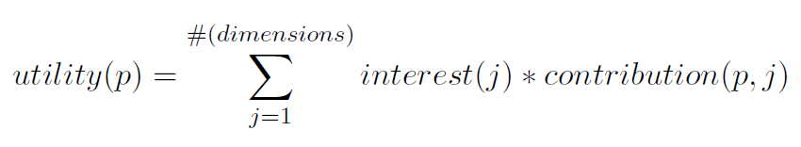
Customer-specific item utilities with MAUT
Customer interests:
Item utilities:
customer | quality | economy
Cu₁ | 80% | 20%
Cu₂ | 40% | 60%
*
quality | economy | utility: cu₁ | utility: cu₂
P1 Σ(5,4,6,6,3,7,10) = 41 | Σ (10,10,9,10,10,10,6) = 65 | 45.8 [8] | 55.4 [6]
P2 Σ(5,4,6,6,10,10,8) = 49 | Σ (10,10,9,10,7,8,10) = 64 | 52.0 [7] | 58.0 [1]
P3 Σ(5,4,10,6,10,10,8) = 53 | Σ (10,10,6,10,7,8,10) = 61 | 54.6 [5] | 57.8 [2]
... | ... | ... | ...
**
*
**

Slide 100
Constraint-based recommendation II
BUT: What if no solution exists?
not satisfiable → debugging of knowledge base
not satisfiable but
correct → debugging of user requirements
Application of model-based diagnosis for debugging user requirements
Diagnoses: is satisfiable
Repairs: is satisfiable
Conflict sets: not satisfiable

Slide 101
Example: find minimal relaxations (minimal diagnoses)
Knowledge Base:
Product catalogue:
 | LHS | RHS
C1 | TRUE | Brand = Brand pref.
C2 | Motives = Landscape | Low. foc. Length =< 28
C3 | TRUE | Price =< Max. cost
Powershot XY
Brand | Canon
Lower focal length | 35
Upper focal length | 140
Price | 420 EUR
Current user:
 | User model (SRS)
R1 | Motives | Landscape
R2 | Brand preference | Canon
R3 | Max. cost | 350 EUR
Lumix
Brand | Panasonic
Lower focal length | 28
Upper focal length | 112
Price | 319 EUR
CS1
CS2
Diagnoses:

Slide 102
Ask user
Computation of minimal revisions of requirements
Do you want to relax your brand preference?
Accept Panasonic instead of Canon brand
Or is photographing landscapes with a wide-angle lens and maximum cost less important?
Lower focal length > 28mm and Price > 350 EUR
Optionally guided by some predefined weights or past community behavior
Be aware of possible revisions (e.g. age, family status, …)

Slide 103
Constraint-based recommendation III
More variants of recommendation task
Customers maybe not know what they are seeking
Find "diverse" sets of items
Notion of similarity/dissimilarity
Idea that users navigate a product space
If recommendations are more diverse than users can navigate via critiques on recommended "entry points" more efficiently (less steps of interaction)
Bundling of recommendations
Find item bundles that match together according to some knowledge
E.g. travel packages, skin care treatments or financial portfolios
RS for different item categories, CSP restricts configuring of bundles

Slide 104
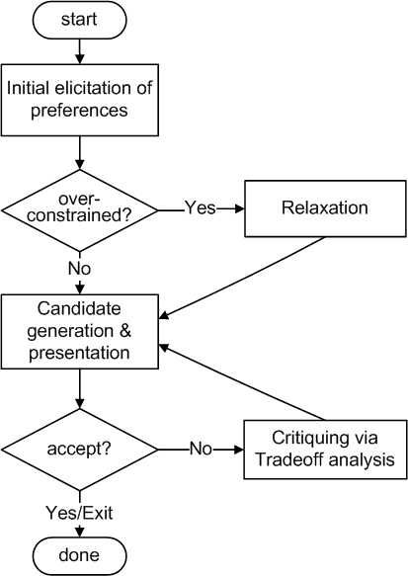
Conversational strategies
Process consisting of multiple conversational moves
Resembles natural sales interactions
Not all user requirements known beforehand
Customers are rarely satisfied with the initial recommendations
Different styles of preference elicitation:
Free text query interface
Asking technical/generic properties
Images / inspiration
Proposing and Critiquing

Slide 105
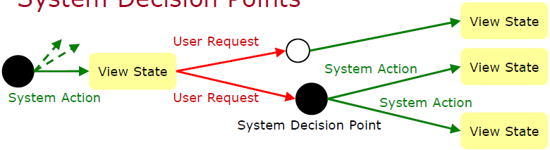
Example: adaptive strategy selection
State model, different actions possible
Propose item, ask user, relax/tighten result set,…
[Ricci et al., JITT, 2009]

Slide 106
Limitations of knowledge-based recommendation methods
Cost of knowledge acquisition
From domain experts
From users
Remedy: exploit web resources
Accuracy of preference models
Very fine granular preference models require many interaction cycles with the user or sufficient detailed data about the user
Remedy: use collaborative filtering, estimates the preference of a user
However: preference models may be instable
E.g. asymmetric dominance effects and decoy items

Slide 107

Hybridization Strategies

Slide 108
Hybrid recommender systems
All three base techniques are naturally incorporated by a good sales assistance (at different stages of the sales act) but have their shortcomings
Idea of crossing two (or more) species/implementations
hybrida [lat.]: denotes an object made by combining two different elements
Avoid some of the shortcomings
Reach desirable properties not present in individual approaches
Different hybridization designs
Monolithic exploiting different features
Parallel use of several systems
Pipelined invocation of different systems

Slide 109
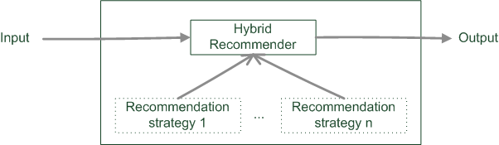
Monolithic hybridization design
Only a single recommendation component
Hybridization is "virtual" in the sense that
Features/knowledge sources of different paradigms are combined

Slide 110
Monolithic hybridization designs: Feature combination
"Hybrid" user features:
Social features: Movies liked by user
Content features: Comedies liked by user, dramas liked by user
Hybrid features: users who like many movies that are comedies, …
“the common knowledge engineering effort that involves inventing good features to enable successful learning” [BHC98]

Slide 111
Monolithic hybridization designs: Feature augmentation
Content-boosted collaborative filtering [MMN02]
Based on content features additional ratings are created
E.g. Alice likes Items 1 and 3 (unary ratings)
Item7 is similar to 1 and 3 by a degree of 0,75
Thus Alice likes Item7 by 0,75
Item matrices become less sparse
Recommendation of research papers [TMA+04]
Citations interpreted as collaborative recommendations
Integrated in content-based recommendation method

Slide 112
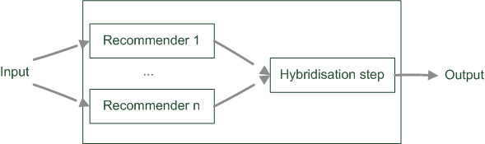
Parallelized hybridization design
Output of several existing implementations combined
Least invasive design
Weighting or voting scheme applied
Weights can be learned dynamically

Slide 113

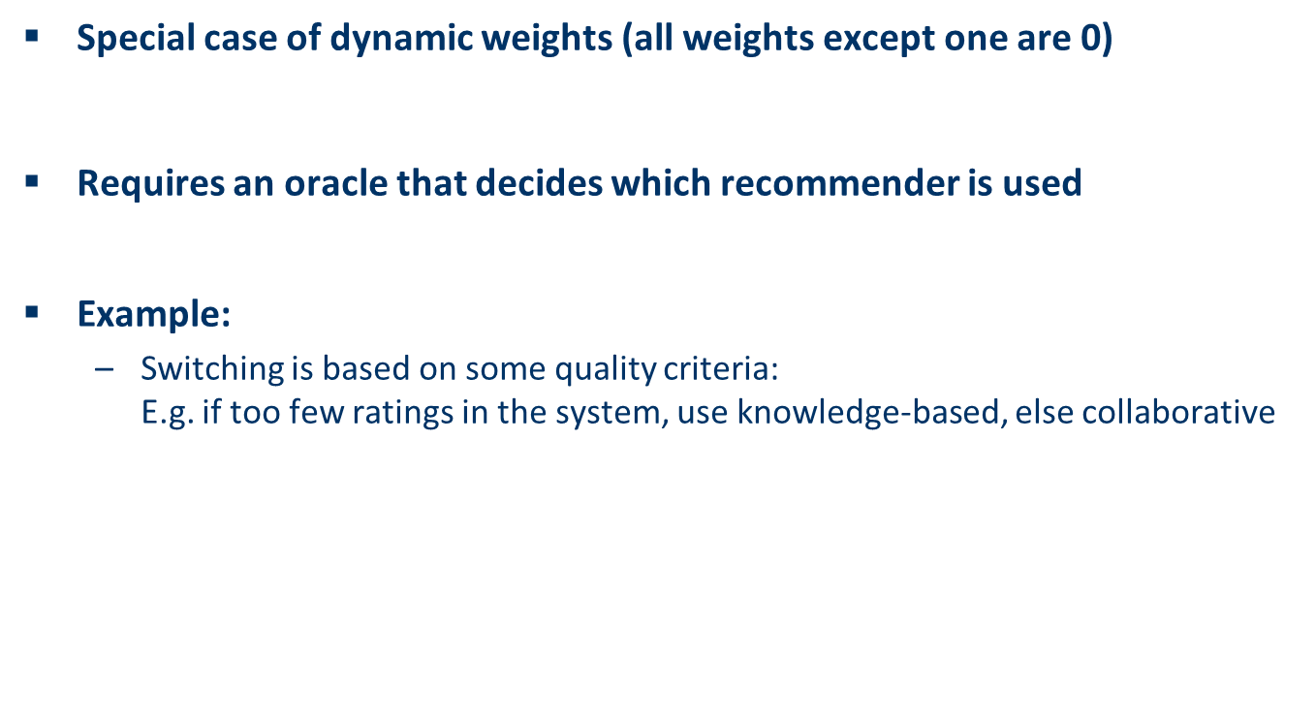
Parallelized hybridization design: Switching
Special case of dynamic weights (all weights except one are 0)
Requires an oracle that decides which recommender is used
Example:
Switching is based on some quality criteria: E.g. if too few ratings in the system, use knowledge-based, else collaborative

Slide 114
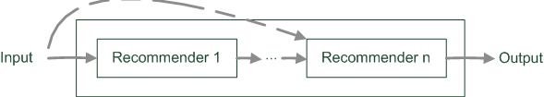
Pipelined hybridization designs
One recommender system pre-processes some input for the subsequent one
Cascade
Meta-level
Refinement of recommendation lists (cascade)
Learning of model (e.g. collaborative knowledge-based meta-level)

Slide 115
Pipelined hybridization designs: Cascade
Recommendation list is continually reduced
First recommender excludes items
Remove absolute no-go items (e.g. knowledge-based)
Second recommender assigns score
Ordering and refinement (e.g. collaborative)

Slide 116
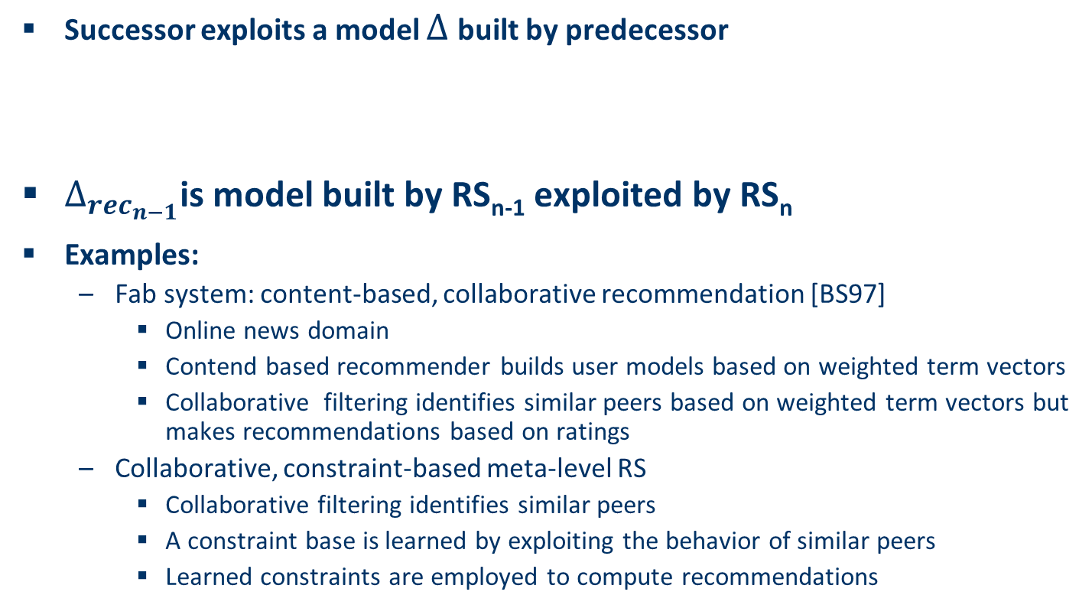
Pipelined hybridization designs: Meta-level
Successor exploits a model $Δ$built by predecessor
$Δ_{{rec}_{n−1}}$is model built by RS_{n-1} exploited by RS_{n}
Examples:
Fab system: content-based, collaborative recommendation [BS97]
Online news domain
Contend based recommender builds user models based on weighted term vectors
Collaborative filtering identifies similar peers based on weighted term vectors but makes recommendations based on ratings
Collaborative, constraint-based meta-level RS
Collaborative filtering identifies similar peers
A constraint base is learned by exploiting the behavior of similar peers
Learned constraints are employed to compute recommendations

Slide 117
What is the best hybridization strategy?
Only few works that compare strategies from the meta-perspective
For instance, [Burke02]
Most datasets do not allow to compare different recommendation paradigms
I.e. ratings, requirements, item features, domain knowledge, critiques rarely available in a single dataset
Some conclusions are supported by empirical findings
Monolithic: preprocessing effort traded-in for more knowledge included
Parallel: requires careful design of scores from different predictors
Pipelined: works well for two antithetic approaches
Netflix competition – “stacking” recommender systems
Weighted design based on >100 predictors – recommendation functions
Adaptive switching of weights based on user model, parameters

Slide 118

Advanced topics I
Explanations in recommender systems

Slide 119
Explanations in recommender systems
Motivation
“The digital camera Profishot is a must-buy for you because . . . .”
Why should recommender systems deal with explanations at all?
The answer is related to the two parties providing and receiving recommendations:
A selling agent may be interested in promoting particular products
A buying agent is concerned about making the right buying decision

Slide 120
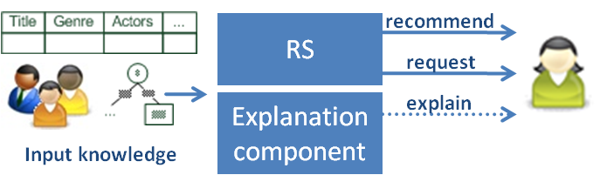
Explanations in recommender systems
Additional information to explain the system’s output following some objectives

Slide 121
Objectives of explanations
Transparency
Validity
Trustworthiness
Persuasiveness
Effectiveness
Efficiency
Satisfaction
Relevance
Comprehensibility
Education

Slide 122
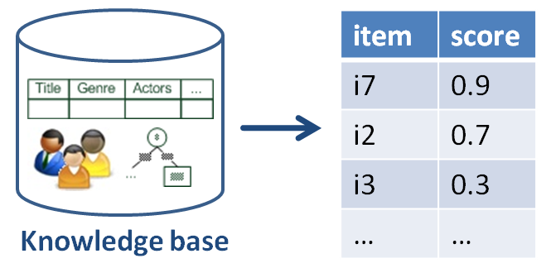


Explanations in general
How? and Why? explanations in expert systems
Form of abductive reasoning
Given: ${KB\text{⊨}}_{RS}i$ (item i is recommended by method RS)
Find $KB^{′}⊆KB$s.t. ${KB^{′}\text{⊨}}_{RS}i$
Principle of succinctness
Find smallest subset of $KB^{′}⊆KB$s.t. ${KB^{′}\text{⊨}}_{RS}i$
i.e. for all $KB′′⊂KB^{′}$holds${{ KB}^{′′}\text{⊭} }_{RS}i$
But additional filtering
Some parts relevant for deduction, might be obvious for humans
[Friedrich & Zanker, AI Magazine, 2011]

Slide 123

Taxonomy for generating explanations in RS
Major design dimensions of current explanation components:
Category of reasoning model for generating explanations
White box
Black box
RS paradigm for generating explanations
Determines the exploitable semantic relations
Information categories

Slide 124

RS paradigms and their ontologies
Classes of objects
Users
Items
Properties
N-ary relations between them
Collaborative filtering
Neighborhood based CF (a)
Matrix factorization (b)
Introduces additional factors as proxies for determining similarities

Slide 125
RS paradigms and their ontologies
Content-based
Properties characterizing items
TF*IDF model
Knowledge based
Properties of items
Properties of user model
Additional mediating domain concepts

Slide 126



Similarity between items
Similarity between users
Tags
Tag relevance (for item)
Tag preference (of user)

Slide 127



Thermencheck.com (hot spring resorts)
It offers services for families with small children, such as X, Y and Z.
It is a spa resort of medium size offering around 1000 beds.
The water has favorable properties for X, but it is unknown if it also cures Y.
It offers organic food, but no kosher food.

Slide 128
Results from testing the explanation feature
+**
Positive
Usage exp.
Perceived
Utility
+**
+*
Recommend others
+**
Explanation
+
Intention to repeated usage
+**
Trust
** sign. < 1%, * sign. < 5%
Knowledgeable explanations significantly increase the users’ perceived utility
Perceived utility strongly correlates with usage intention etc.

Slide 129
Explanations in recommender systems: Summary
There are many types of explanations and various goals that an explanation can achieve
Which type of explanation can be generated depends greatly on the recommender approach applied
Explanations may be used to shape the wishes and desires of customers but are a double-edged sword
On the one hand, explanations can help the customer to make wise buying decisions;
On the other hand, explanations can be abused to push a customer in a direction which is advantageous solely for the seller
As a result a deep understanding of explanations and their effects on customers is of great interest.

Slide 130
Advanced topics II
Online consumer decision making
RS are about Human decision making

Slide 131
Reality check regarding F₁ and accuracy measures for RS
Real value for companies lies in increasing conversions
... and satisfaction with bought items, low churn rate
Some reasons why it might be a fallacy to think F₁ on historical data is a good estimate for real conversion:
Recommendation can be self-fulfilling prophecy
Users’ preferences are not invariant, but can be constructed [ALP03]
Position/Rank is what counts (e.g. serial position effects)
Actual choices are heavily biased by the item’s position [FFG+07]
Inclusion of weak (dominated) items increases users’ confidence
Replacing some recommended items by decoy items fosters choice towards the remaining options [TF09]
…

Slide 132
Consequently
The understanding of online users' purchasing behavior is of high importance for companies
This purchasing behavior can be explained by different models of human decision making

Slide 133
Effort of decision versus accuracy
Model focuses on cost-benefit aspects
People attempt to make accurate choices
People want to minimize effort
Some methods for making choices are highly accurate
They involve considering a lot of information
Calculating expected utility is a high-accurate and high-effort way of making a choice
Some methods are simpler
They involve considering less information
Also called heuristics

Slide 134
Examples of decision heuristics
Simplification is an underlying concept of heuristics
Satisficing
Choose the first item that is satisfactory
Elimination by Aspects
Start with the most important attribute
Eliminate all item that are not satisfactory
Proceed with the next most important attribute
Come up with evolved set
Reason-based choice
People want to be able to justify their choices
May make decisions that are easiest to justify

Slide 135
Some decision phenomena due to heuristics
Phenomenon/Effect | Description
Decoy effects | Additional irrelevant (inferior) items in an item set significantly influence the selection behavior
Primacy/recency effects | Items at the beginning and the end of a list are analyzed significantly more often/deeply than items in the middle of a list
Framing effects | The way in which different decision alternatives are presented influences the final decision taken
Priming | If specific decision properties are made more available in memory, this influences a consumer's item evaluations (background priming)
Defaults | Preset options bias the decision process

Slide 136
Decoy: asymmetric dominance effect
Product A dominates D in both dimensions (price and download limit)
Product B dominates alternative D in only one dimension (price)
The additional inclusion of D into the choice set could trigger an increase of the selection probability of A
Product | A | B | D
price per month | 30 | 20 | 50
download limit | 10GB | 6GB | 9GB

Slide 137



Example impact of decoy effect

Slide 138
Personality
Different personality properties pose specific requirements on the design of recommender user interfaces
Some personality traits are more susceptible to heuristical simplifications
Provide various interfaces

Slide 139
Personality traits
Theory | Description
Internal vs. external Locus of control (LOC) | Externally influenced users need more guidance; internally controlled users want to actively and selectively search for additional information
Need for closure | Describes the individual pursuit of making a decision as soon as possible
Maximizer vs. satisficer | Maximizers try to find an optimal solution; satisficers search for solutions that fulfill their basic requirements

Slide 140
Summary of online consumer decision making
Recommender systems are persuasive systems
Estimated-utility is often not a good model of human decision making
Several simplifying heuristics
Bounded rationality / accuracy-effort-tradeoff makes users susceptible for decision biases
Decoy effects, position effects, framing, priming, defaults,…
Different personality characteristics require different recommender interaction methods (Max/sat., need4closure, trust, locOfcontrol)

Slide 141
Outlook
Additional topics covered by the book “Recommender Systems - An Introduction”
Case study on the Mobile Internet
Attacks on CF Recommender Systems
Recommender Systems in the next generation Web (Social Web, Semantic Web)
More on consumer decision making
Recommending in ubiquitous environments
Current and emerging topics in RS
Social Web recommendations
Context-aware recommendation
Learning-to-rank

Slide 142

Thank you for your attention!
http://recsys.acm.org
Questions?
Questions?
Questions?
http://www.recommenderbook.net
Recommender Systems – An Introduction by
Dietmar Jannach, Markus Zanker, Alexander Felfernig and Gerhard Friedrich
Cambridge University Press, 2010
Dietmar Jannach
e-Services Research Group
Department of Computer Science
TU Dortmund, Germany
M: dietmar.jannach@tu-dortmund.de
P: +49 231 755 7272
Markus Zanker and Gerhard Friedrich
Intelligent Systems and Business Informatics
Institute of Applied Informatics
University Klagenfurt, Austria
M: firstname.lastname@uni-klu.ac.at
P: +43 463 2700 3705

Slide 143
References
[Adomavicius & Tuzhilin, IEEE TKDE, 2005] Adomavicius G., Tuzhilin, A. Toward the next generation of recommender systems: a survey of the state-of-the-art and possible extensions, IEEE TKDE, 17(6), 2005, pp.734-749.
[ALP03] Ariely, D., Loewenstein, G., Prelec, D. (2003) “Coherent Arbitrainess”: Stable Demand Curves Without Stable Preferences. The Quarterly Journal of Economics, February 2003, 73-105.
[BKW+10] Bollen, D., Knijnenburg, B., Willemsen, M., Graus, M. (2010) Understanding Choice Overload in Recommender Systems. ACM Recommender Systems, 63-70.
[Brynjolfsson et al., Mgt. Science, 2003] Brynjolfsson, E., Hu, Y., Smith, M.: Consumer Surplus in the Digital Economy: Estimating the Value of Increased Product Variety at Online Booksellers, Management Science, Vol 49(11), 2003, pp. 1580-1596.
[BS97] Balabanovic, M., Shoham, Y. (1997) Fab: content-based, collaborative recommendation, Communications of the ACM, Vol. 40(3), pp. 66-72.
[FFG+07] Felfernig, A. , Friedrich, G., Gula, B. et al. (2007) Persuasive recommendation: serial position effects in knowledge-based recommender systems. 2nd international conference on Persuasive technology, Springer, 283–294.
[Friedrich& Zanker, AIMag, 2011] Friedrich, G., Zanker, M.: A Taxonomy for Generating Explanations in Recommender Systems. AI Magazine, Vol. 32(3), 2011.
[Jannach et al., CUP, 2010] Jannach D., Zanker M., Felfernig, A., Friedrich, G.: Recommender Systems an Introduction, Cambridge University Press, 2010.
[Jannach et al., JITT, 2009] Jannach, D., Zanker, M., Fuchs, M.: Constraint-based recommendation in tourism: A multi-perspective case study, Information Technology & Tourism, Vol 11(2), pp. 139-156.
[Jannach, Hegelich 09] Jannach, D., Hegelich K.: A case study on the effectiveness of recommendations in the Mobile Internet, ACM Conference on Recommender Systems, New York, 2009, pp. 205-208
[Ricci et al., JITT, 2009] Mahmood, T., Ricci, F., Venturini, A.: Improving Recommendation Effectiveness by Adapting the Dialogue Strategy in Online Travel Planning. Information Technology & Tourism, Vol 11(4), 2009, pp. 285-302.
[Teppan& Felfernig, CEC, 2009] Teppan, E., Felfernig, A.: Asymmetric Dominance- and Compromise Effects in the Financial Services Domain. IEEE International Conference on E-Commerce and Enterprise Computing, 2009, pp. 57-64
[TF09] Teppan, E., Felfernig, A. (2009) Impacts of decoy elements on result set evaluations in knowledge-based recommendation. Int. J. Adv. Intell. Paradigms 1, 358–373.

Slide 144
References
[Xiao & Benbasat, MISQ, 2007] Xiao, B., Benbasat, I.: E-Commerce Product Recommendation Agents: Use, Characteristics, and Impact, MIS Quarterly, Vol 31(1), pp. 137-209.
[Zanker et al., EC-Web, 2006] Zanker, M., Bricman, M., Gordea, S., Jannach, D., Jessenitschnig, M.: Persuasive online-selling in quality & taste domains, 7th International Conference on Electronic Commerce and Web Technologies, 2006, pp. 51-60.
[Zanker, RecSys, 2008] Zanker M., A Collaborative Constraint-Based Meta-Level Recommender. ACM Conference on Recommender Systems, 2008, pp. 139-146.
[Zanker et al., UMUAI, 2009] Zanker, M., Jessenitschnig, M., Case-studies on exploiting explicit customer requirements in recommender systems, User Modeling and User-Adapted Interaction, Springer, 2009, pp.133-166.
[Zanker et al., JITT, 2009] Zanker M., Jessenitschnig M., Fuchs, M.: Automated Semantic Annotations of Tourism Resources Based on Geospatial Data, Information Technology & Tourism, Vol 11(4), 2009, pp. 341-354.
[Zanker et al., Constraints, 2010] Zanker M., Jessenitschnig M., Schmid W.: Preference reasoning with soft constraints in constraint-based recommender systems. Constraints, Springer, Vol 15(4), 2010, pp. 574-595.

